Slide 1
BAI3020 Strategic Planning & Project Management
Introduction to Project Management
BAI3020 – Rajiv Dua

Slide 2
Project Management
What is Project Management?
http://www.youtube.com/watch?v=bLrnJc2Tz44

Slide 3
Introduction
Pyramids of Egypt
1942 Manhattan project - Atomic bomb and Dr. Oppenheimer and org. chart
Network diagram defined in the 1950’s on cold war defense programs in particular Polaris missile and submarine project
1990’s project management went viral; health care, manufacturing, software and natural resources.
Source: Eric Verzuh, The Fast Forward MBA in Project Management, 2008, p 3
The world as a whole spends nearly $10 trillion of its $40.7 trillion gross product on projects of all kinds
More than 16 million people regard project management as their profession

Slide 4
Motivation for Studying Project Management
Projects have had a terrible track record
For example a 1995 Standish Group study (CHAOS) found that only 16.2% of IT projects were successful in meeting scope, time, and cost goals; over 31% of IT projects were canceled before completion
A PricewaterhouseCoopers study found that overall, half of all projects fail and only 2.5% of corporations consistently meet their targets for scope, time, and cost goals for all types of project

Slide 5
Why Project Management?
Better control of financial, physical, and human resources
Improved customer relations
Shorter development times
Lower costs
Higher quality and increased reliability
Higher profit margins
Improved productivity
Better internal coordination
Higher worker morale

Slide 6
What Is a Project?
Know This!
A project is “a temporary endeavor undertaken to create a unique product, service, or result” (PMBOK® Guide, Fourth Edition, 2008, p. 5)
Operations or work done to sustain the business
Projects end when their objectives have been reached or the project has been terminated
Projects can be large or small and take a short or long time to complete

Slide 7
Examples of a Project
A tire company requires to incorporate an RFID system to manage their Tire inventory efficiently
Installation of the solar reference array at NAIT
A college campus upgrades its technology infrastructure to provide wireless Internet access across the whole campus
A cross-functional task force in a company decides what Voice-over-Internet-Protocol (VoIP) system to purchase and how it will be implemented
Exercise: In small groups discuss any related project you may have worked on? prepare to discuss?

Slide 8
Project Attributes
A project:
Has a unique purpose
Is temporary
Is developed using progressive elaboration
Requires resources, often from various areas
Should have a primary customer or sponsor
The project sponsor usually provides the direction and funding for the project
Involves uncertainty

Slide 9
Project and Program Managers
Project managers work with project sponsors, the project team, and other people involved in a project to meet project goals
Program is a group of related projects managed in a coordinated way to obtain benefits and control not available from managing them individually (PMBOK® Guide, Fourth Edition, 2008, p. 9)
Program managers oversee programs; often act as bosses for project managers

Slide 10
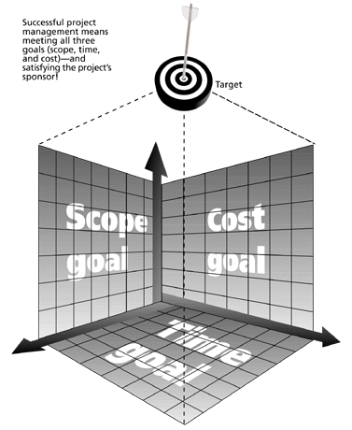
The Triple Constraint of Project Management
Successful project management means meeting all three goals (scope, time, and cost) – and satisfying the project’s sponsor!

Slide 11
What is Project Management?
Project management is “the application of knowledge, skills, tools and techniques to project activities to meet project requirements” (PMBOK® Guide, Fourth Edition, 2008, p. 6)
Project managers strive to meet the triple constraint by balancing project scope, time, and cost goals

Slide 12
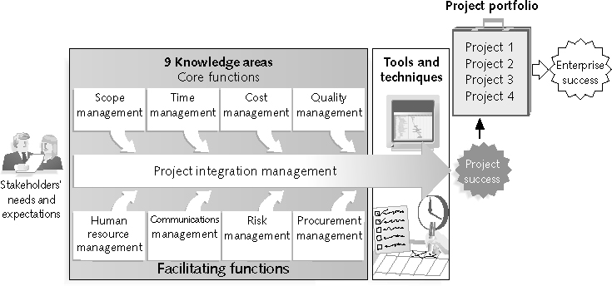
Project Management Framework
Project Management Framework

Slide 13
Project Stakeholders
Stakeholders are the people involved in or affected by project activities
Stakeholders include:
The project sponsor
The project manager
The project team
Functional Manager
Support staff
Customers
Users
Suppliers
Internal and external clients
Opponents to the project

Slide 14
9 Project Management Knowledge Areas
Knowledge areas describe the key competencies that project managers must develop
4 core knowledge areas lead to specific project objectives (scope, time, cost, and quality)
4 facilitating knowledge areas are the means through which the project objectives are achieved (human resources, communication, risk, and procurement management
1 knowledge area (project integration management) affects and is affected by all of the other knowledge areas
All knowledge areas are important!

Slide 15
Project Management Tools and Techniques
Project management tools and techniques assist project managers and their teams in various aspects of project management:
Project charter, scope statement, and WBS (scope)
Gantt charts, network diagrams, critical path analysis, critical chain scheduling (time)
Cost estimates and earned value management (cost)

Slide 16
Super Tools
“Super tools” are those tools that have high use and high potential for improving project success, such as:
Software for task scheduling (such as project management software)
Scope statements
Requirements analyses
Lessons-learned reports
Tools already extensively used that have been found to improve project importance include:
Progress reports
Kick-off meetings
Gantt charts
Change requests

Slide 17
Project Success
There are several ways to define project success:
The project met scope, time, and cost goals
The project satisfied the customer/sponsor
The results of the project met its main objective, such as making or saving a certain amount of money, providing a good return on investment, or simply making the sponsors happy

Slide 18
What Helps Projects Succeed?*
1. Executive support
2. User involvement
3. Experienced project
manager
4. Clear business objectives
5. Minimized scope
6. Standard software
infrastructure
7. Firm basic requirements
8. Formal methodology
9. Reliable estimates
10. Other criteria, such as
small milestones, proper
planning, competent
staff, and ownership
*The Standish Group, “Extreme CHAOS,” (2001).

Slide 19
Program and Project Portfolio Management
A program is “a group of related projects managed in a coordinated way to obtain benefits and control not available from managing them individually” (PMBOK® Guide, Fourth Edition, 2008, p. 9)
A program manager provides leadership and direction for the project managers heading the projects within the program

Slide 20
Best Practice
A best practice is “an optimal way recognized by industry to achieve a stated goal or objective”*
Make sure your projects are driven by your strategy
Engage your stakeholders
Ignoring stakeholders often leads to project failure; be sure to engage stakeholders at all stages of a project, and encourage teamwork and commitment at all times

Slide 21
Suggested Skills for Project Managers
Project managers need a wide variety of skills
They should:
Be comfortable with change
Understand the organizations they work in and with
Be able to lead teams to accomplish project goals

Slide 22
The Role of the Project Manager
Job descriptions vary, but most include responsibilities like planning, scheduling, coordinating, and working with people to achieve project goals
Remember that 97% of successful projects were led by experienced project managers, who can often help influence success factors

Slide 23
Suggested Skills for Project Managers
The Project Management Body of Knowledge
Application area knowledge, standards, and regulations
Project environment knowledge
General management knowledge and skills
Soft skills or human relations skills

Slide 24
Ten Most Important Skills and Competencies for Project Managers
1. People skills
2. Leadership
3. Listening
4. Integrity, ethical behavior, consistent
5. Strong at building trust
6. Verbal communication
7. Strong at building teams
8. Conflict resolution, conflict management
9. Critical thinking, problem solving
10. Understands, balances priorities

Slide 25
Importance of Leadership Skills
Effective project managers provide leadership by example
A leader focuses on long-term goals and big-picture objectives while inspiring people to reach those goals
A manager deals with the day-to-day details of meeting specific goals
Project managers often take on the role of both leader and manager

Slide 26
History of Project Management
Some people argue that building the Egyptian pyramids was a project, as was building the Great Wall of China
Most people consider the Manhattan Project to be the first project to use “modern” project management
This three-year, $2 billion (in 1946 dollars) project had a separate project manager and a technical manager

Slide 27
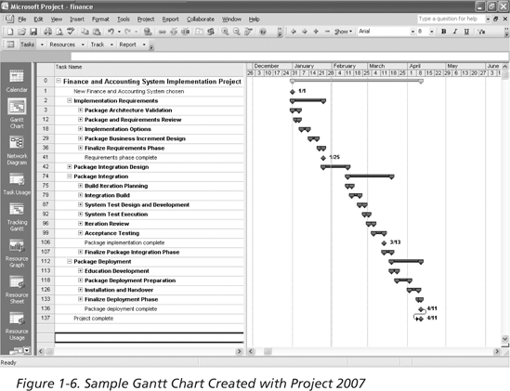
Sample Gantt Chart Created with Project 2007

Slide 28
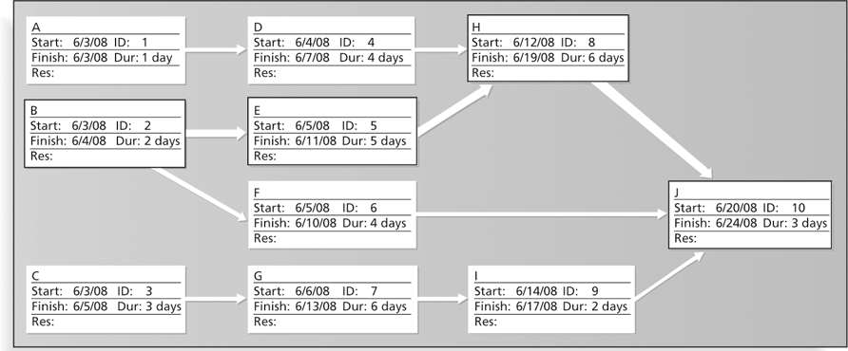
Sample Network Diagram in Microsoft Project

Slide 29
The Project Management Institute
The Project Management Institute (PMI) is an international professional society for project managers founded in 1969
PMI has continued to attract and retain members, reporting 277,221 members worldwide by August 31, 2008
There are specific interest groups in many areas, like engineering, financial services, health care, IT, etc.
Project management research and certification programs continue to grow
Students can join PMI at a reduced fee (see www.pmi.org for details)

Slide 30
Project Management Certification
PMI provides certification as a Project Management Professional (PMP) and the (CAPM)
A PMP has documented sufficient project experience, agreed to follow a code of ethics, and passed the PMP exam
The number of people earning PMP certification is increasing quickly
PMI and other organizations offer additional certification programs (see Appendix B)

Slide 31
Growth in PMP Certification, 1993-2008

Slide 32
Chapter Summary
A project is a temporary endeavor undertaken to create a unique product, service, or result
Project management is the application of knowledge, skills, tools, and techniques to project activities to meet project requirements
A program is a group of related projects managed in a coordinated way
Project managers play a key role in helping projects and organizations succeed
The project management profession continues to grow and mature

Slide 33

Questions

